Slide 1

DEPARTMENT OF ARTIFICIAL INTELLIGENCE AND DATA SCIENCE ACADEMIC YEAR 2025 - 2026 SEMESTER III ARTIFICIAL INTELLIGENCE LABORATORY MINI PROJECT REVIEW Text based game using tkinter
REGISTER NUMBER
NAME | ARJUN V
YEAR | II
SECTION | A
FACULTY IN-CHARGE | Mrs. M. Divya

Slide 2
PROBLEM STATEMENT
Brief Overview:
This project is a simple AI-based interactive storytelling game built using Python’s Tkinter module. It demonstrates how AI decision-making works by letting the player choose different paths that lead to various outcomes. Each choice represents a logical decision, similar to how AI makes decisions based on conditions. The project aims to show how basic AI logic can be applied to create engaging and intelligent story-based applications.
Problem Statement:
This project is designed to create an interactive story-based adventure game using Artificial Intelligence concepts in a simple form of decision-making. The program allows the user to make choices that affect the story’s outcome, simulating the way AI systems make decisions based on given inputs. The aim is to demonstrate how logical flow and conditional branching can be used to mimic basic AI behavior in storytelling.
Expected Result:
The program provides an engaging user experience where each decision leads to a different outcome — win or lose — representing the AI concept of state-based decision-making. This showcases how AI logic can be applied to create intelligent, interactive systems in entertainment and learning applications.
Possibilities:
This project can be expanded by adding more story paths, AI-based decision suggestions, voice interaction, or adaptive storylines that change based on user behavior — making it more intelligent and immersive.

Slide 3
THEORETICAL BACKGROUND
Artificial Intelligence (AI) focuses on enabling machines to make decisions similar to humans. One basic AI concept used in this project is decision-based reasoning, where the system chooses actions depending on the current situation.The adventure game works on the idea of a state transition model, where each story part represents a state, and user choices decide the next state. This is similar to a finite state machine (FSM) or a decision tree, commonly used in AI for logical flow and decision-making.The program uses simple rule-based logic, where each condition or choice leads to a specific outcome. Though basic, this approach represents how intelligent agents make logical moves in response to different conditions, forming the foundation of many AI-driven systems like games and simulations.

Slide 4
IMPLEMENTATION AND CODE
Link to code in Git-hub Repository
List | Git-hub Repository Links
Implementation of Code Link | https://github.com/Arjun240025/AI_MINI-PROJECT/blob/main/AI%20src%20code
Word Document Report Link | https://github.com/Arjun240025/AI_MINI-PROJECT/blob/main/arjunLAB_MINI_PROJECT_TEMPLATE_AI%26DS%5B1%5D.docx
PPT Link

Slide 5
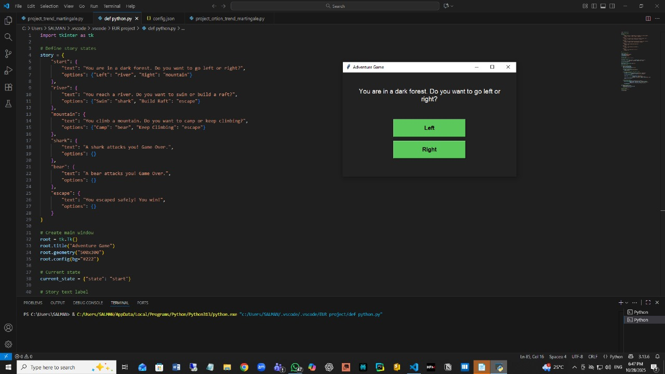
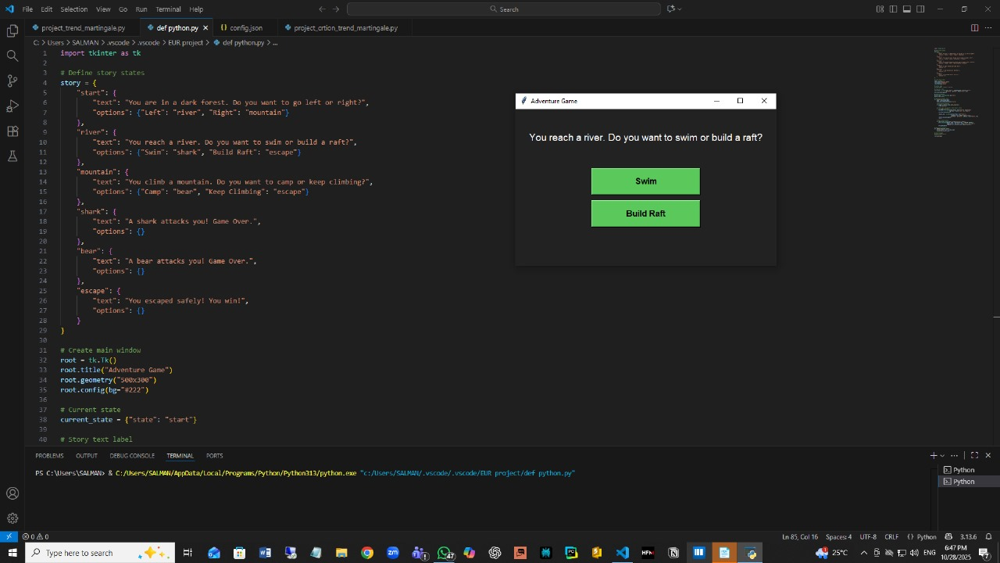
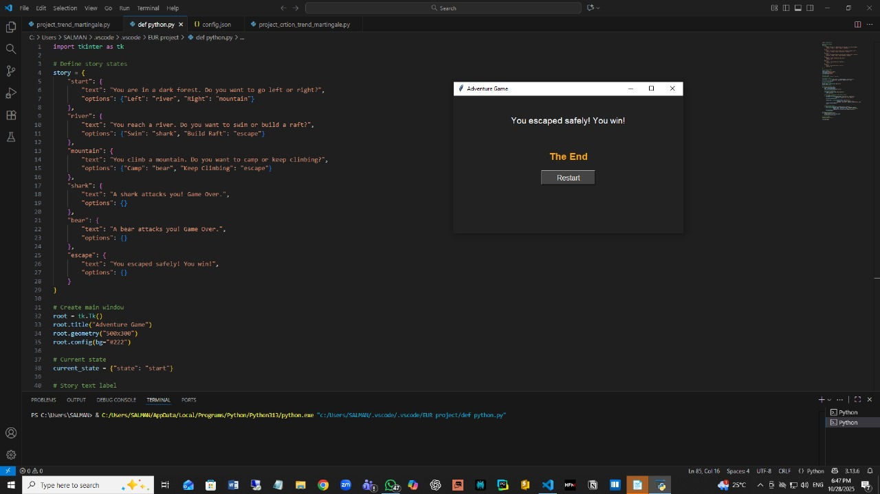
OUTPUT AND RESULTS
OUTPUT :
EXPLANATION :
Start Screen: Player chooses to go Left or Right in a dark forest.
River Scene: Choosing Left leads to a river where the player decides to Swim or Build Raft.
End Screen: Successful choices lead to the message “You escaped safely! You win!” with a Restart option.

Slide 6
OUTPUT AND RESULTS
Result
The project successfully simulates a simple AI-based decision-making game using Python and Tkinter.It allows users to make choices, navigate through different story paths, and experience various outcomes like winning or game over.This demonstrates how state transitions and logical decisions form the basis of AI reasoning in an interactive environment.
Future Enhancement
Add voice input and output using speech recognition for better interaction.Include machine learning to make the game adapt to player behavior.Expand the story with more states and random events for replayability.Add graphics, sounds, and animations to make the gameplay more engaging.

Slide 7
REFERENCES
1. Python Software Foundation. (2024). Tkinter — Python’s de-facto standard GUI package.Retrieved from: https://docs.python.org/3/library/tkinter.html
2. GeeksforGeeks. (2023). Decision Tree Introduction in Artificial Intelligence.Retrieved from: https://www.geeksforgeeks.org/decision-tree-introduction/
3. TutorialsPoint. (2023). Artificial Intelligence – Decision Making.Retrieved from: https://www.tutorialspoint.com/artificial_intelligence/artificial_intelligence_decision_making.htm
4. Programiz. (2024). Python Tkinter – Create Simple GUI Programs.Retrieved from: https://www.programiz.com/python-programming/
.5. Analytics Vidhya. (2022). Understanding Finite State Machines and Their Applications in AI.Retrievedfrom
https://www.analyticsvidhya.com/blog/2022/07/finite-state-machines-in-artificial-intelligence/

